Slide 1



Microsoft R Server
Mrinal Chakraborty
Data Insights Team
Microsoft India
Programing: SAS, R-Server, TensorFlow and Scala
Big-Data: Cloudera Hadoop certification and Spark Ecosystem
Machine learning: Logistic Regression, Neural Networks, Support vector machines, XGBoost, Classification and Association rules
Allied Analytics skills: Visualisation, Marketing & Web analytics
Certifications: PMP, Certified Scrum Master & Certified in Business analytics from Indian School of Business http://www.isb.edu/cba/

Slide 2



This Talk is to get you Excited around Microsoft R-Server

Slide 3

Microsoft R Server (MRS)
Introduction

Slide 4
What is R?
Language Platform
A programming language for statistics, analytics, and data science
A data visualization framework
Provided as Open Source
Used by 3.5M+ data scientists, statisticians and analysts
Taught in most university statistics programs
New and recent graduates prefer it
Active and thriving user groups across the world
Community
Ecosystem
CRAN: 12000+ freely available algorithms, test data and evaluation
Many of these are applicable to big data if scaled

Slide 5
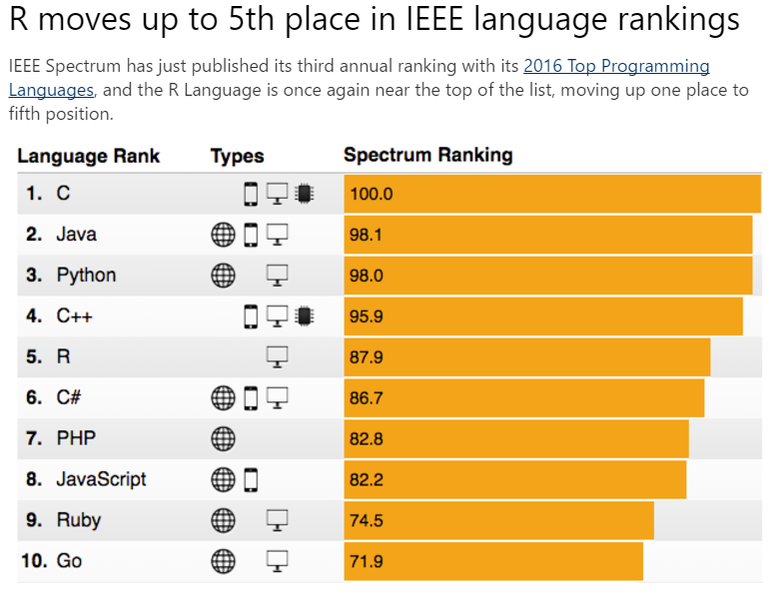
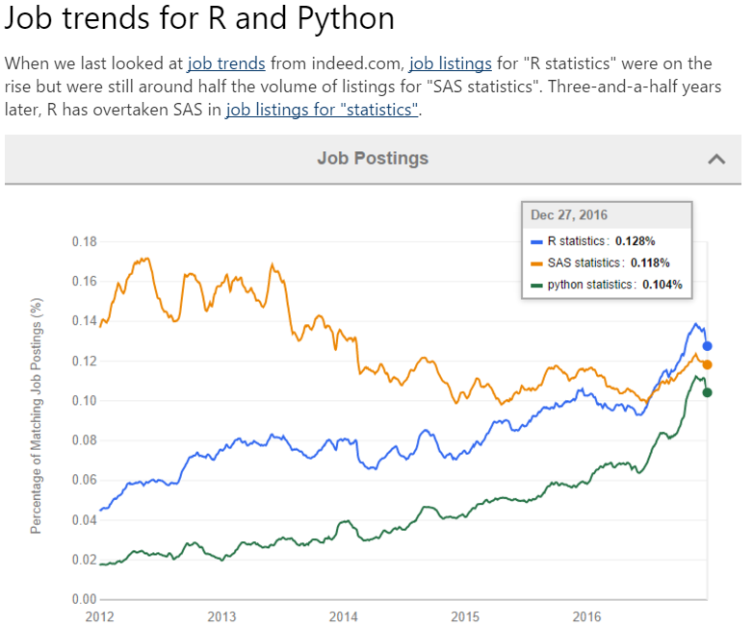
Source : http://blog.revolutionanalytics.com/popularity/

Slide 6

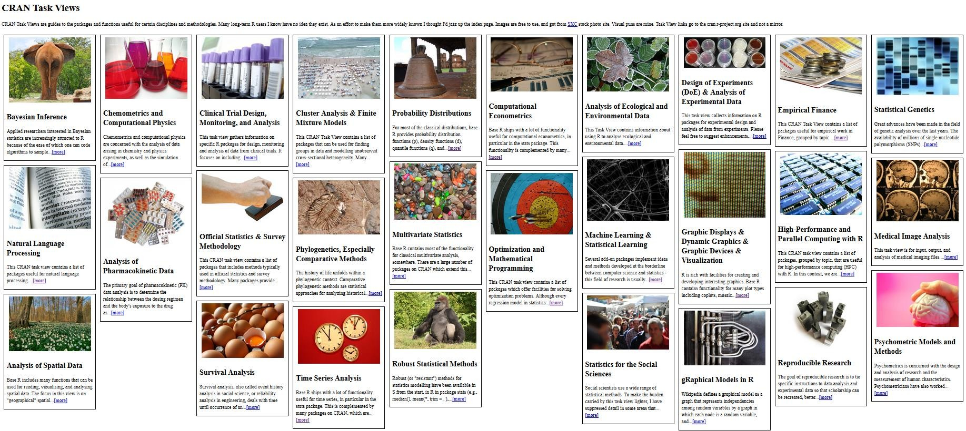

CRAN
The Comprehensive R Archive Network
Resources For All Fields of Analysis
12,000+ Packages

Slide 7

Microsoft
Microsoft R Open
Free and open source R distribution
Enhanced and distributed by Microsoft
Microsoft R Server
Secure, Scalable and Supported Distribution of R
With commercial components created by Microsoft
Copyright Microsoft Corporation. All rights reserved.

Slide 8













Slide 9
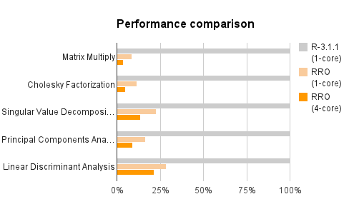
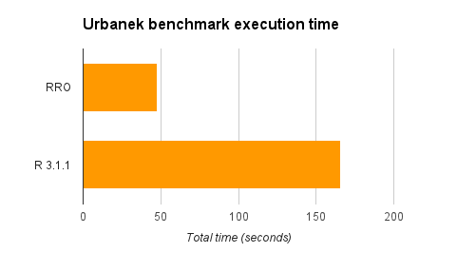
CRAN R compared to Microsoft R Open
Matrix calculation – upto 27x faster
Matrix functions – upto 16x faster
Programation – 0x faster
More efficient and multi-threaded math computation.
Benefits math intensive processing.
No benefit to program logic and data transform

Slide 10

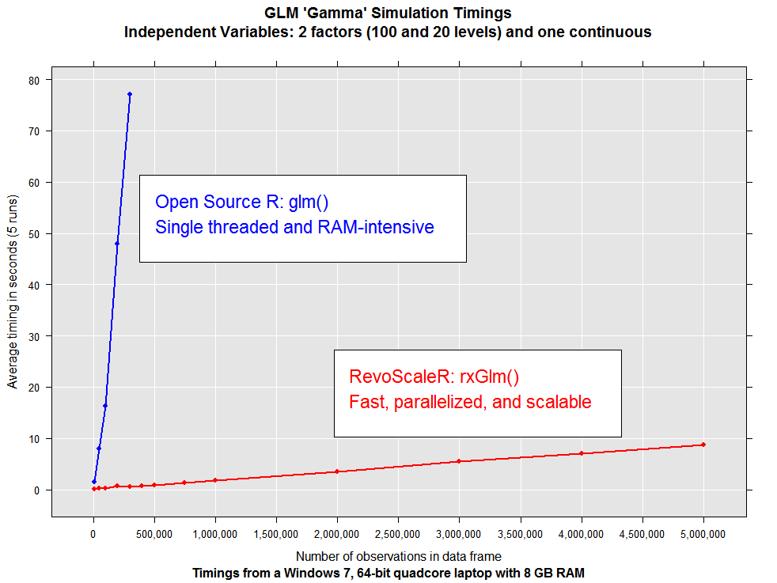
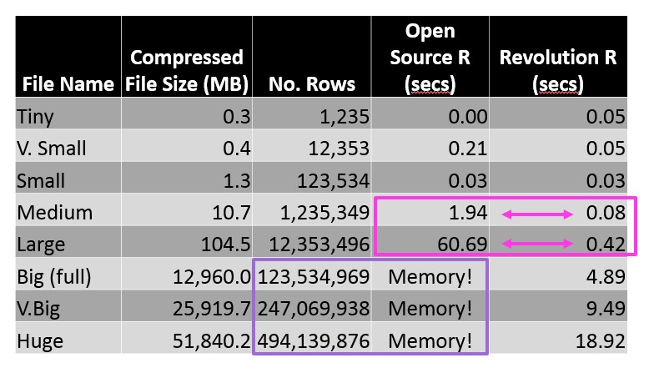
Microsoft R Server has no data size limits in relation to size of available RAM. When open source R operates on data sets that exceed RAM it will fail. In contrast Microsoft R Server scales linearly well beyond RAM limits and parallel algorithms are much faster.
US flight data for 20 years
Linear Regression on Arrival Delay
Run on 4 core laptop, 16GB RAM and 500GB SSD

Slide 11



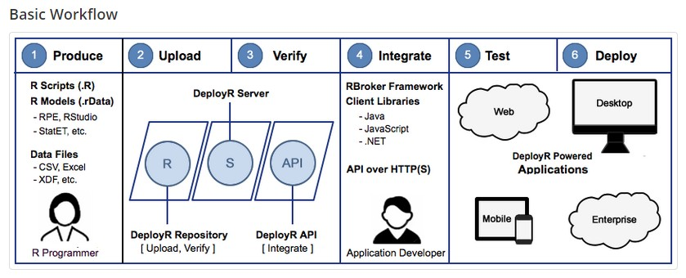

?

Slide 12
R+CRAN
Open source R interpreter
R Open
Microsoft R Server
DeployR RTVS
ConnectR
High-speed & direct connectors
Available for:
High-performance XDF
SAS, SPSS, delimited & fixed
format text data files
Hadoop HDFS (text & XDF)
Teradata Database & Aster
EDWs and ADWs
ODBC
• R 3.2.4
Freely-available huge range of R
algorithms
Algorithms callable by MRO
Embeddable in R scripts
100% Compatible with existing R scripts, functions and packages
ScaleR
Ready-to-Use high-performance
big data big analytics
Fully-parallelized analytics
Data prep & data distillation
Descriptive statistics & statistical tests
Range of predictive functions
User tools for distributing customized R algorithms across nodes
Wide data sets supported – thousands of variables
MRO
Performance enhanced R
interpreter
Based on open source R
Adds high-performance math library to speed up linear algebra functions
DistributedR
Distributed computing framework
Delivers cross-platform portability

Slide 13

Microsoft
R Open
Microsoft
R Server
Datasize |  | In-memory | In-Memory or Disk Based
 | In-memory
Speed of Analysis |  | Multi-threaded | Multi-threaded, parallel processing 1:N servers
 | Single threaded
Support |  | Community | Community + Commercial
 | Community
Analytic Breadth & Depth | 8000+ innovative analytic packages | 8000+ innovative analytic packages | 8000+ innovative packages + commercial parallel high- speed functions
Licence | Open Source | Open Source | Commercial license. Supported release with indemnity

Slide 14


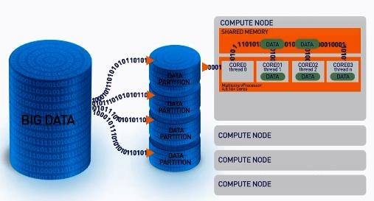
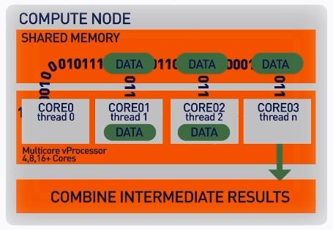
Our ScaleR algorithms work inside multiple cores / nodes in parallel at high speed
Stream data in to RAM in blocks. “Big Data” can be any data size. We handle Megabytes to Gigabytes to Terabytes…
Interim results are collected and combined analytically to produce the output on the entire data set
XDF file format is optimised to work with the ScaleR library and significantly speeds up iterative algorithm processing.

Slide 15

Scale R – Parallelized Algorithms & Functions
Data Preparation
Data import – Delimited, Fixed, SAS, SPSS,
OBDC
Variable creation & transformation Recode variables
Factor variables Missing value handling Sort, Merge, Split
Aggregate by category (means, sums)
Statistical Tests
Chi Square Test
Kendall Rank Correlation Fisher’s Exact Test Student’s t-Test
Variable Selection
Stepwise Regression
▪
▪
▪
▪
▪
▪
▪
▪
▪
▪
▪
▪
Simulation
Simulation (e.g. Monte Carlo)
Parallel Random Number Generation
Sampling
Subsample (observations & variables) Random Sampling
Predictive Models
Sum of Squares (cross product matrix for set variables)
Multiple Linear Regression
Generalized Linear Models (GLM) exponential family distributions: binomial, Gaussian, inverse Gaussian, Poisson, Tweedie. Standard link functions: cauchit, identity, log, logit, probit. User defined distributions & link functions.
Covariance & Correlation Matrices Logistic Regression
Classification & Regression Trees Predictions/scoring for models Residuals for all models
▪
▪
▪
▪
Cluster Analysis
K-Means
Descriptive Statistics
Min / Max, Mean, Median (approx.)
Quantiles (approx.) Standard Deviation Variance Correlation Covariance
Sum of Squares (cross product matrix for set variables)
Pairwise Cross tabs
Risk Ratio & Odds Ratio
Cross-Tabulation of Data (standard tables & long form)
Marginal Summaries of Cross Tabulations
▪
▪
▪
▪
▪
▪
▪
▪
▪
Classification
Decision Trees Decision Forest
Gradient Boosted Decision Trees
Naïve Bayes
▪
▪
▪
▪
▪
▪
▪
▪
▪
▪
▪
▪
▪
▪
Combination
rxDataStep rxExec PEMA API
▪
▪
▪
▪

Slide 16


Slide 17
Write Once Deploy Anywhere
ScaleR functions can run in-Hadoop or in-Database without any functional R
recoding
Local Parallel – Linux or Windows
In – Hadoop
SQL Server
# SETUP LINUX ENVIRONMENT VARIABLES | myHadoopCluster <- RxHadoopMR() rxSetComputeContext(myHadoopCluster) hdfsFS <- RxHdfsFileSystem() hdfsFS
rxSetComputeContext("localpar")
# CREATE LINUX, DIRECTORY AND FILE OBJECTS
linuxFS <- RxNativeFileSystem()
AirlineDataSet <-
RxXdfData(“AirlineDemoSmall.xdf”, fileSystem =
linuxFS)
# SETUP SQLSERVER ENVIRONMENT VARIABLES
mySqlServer <- RxInSqlServer()
# SQL SERVER COMPUTE CONTEXT AND TABLE REF
rxSetComputeContext(mySqlServer)
AirlineDataSet <- RxSqlServerData(table=“AirlineDemoSmall”)
R script – does not
need to change to run across different platforms
### ANALYTICAL PROCESSING ###
### Statistical Summary of the data
rxSummary(~ArrDelay+DayOfWeek, data= AirlineDataSet, reportProgress=1)
### CrossTab the data
rxCrossTabs(ArrDelay ~ DayOfWeek, data= AirlineDataSet, means=T)
### Linear Model and plot
hdfsXdfArrLateLinMod <- rxLinMod(ArrDelay ~ DayOfWeek + 0 , data = AirlineDataSet) plot(hdfsXdfArrLateLinMod$coefficients)

Slide 18






The Challenge of Traditional Predictive Analytic Approach
Query
Request
Predictive & BI App’s
Data
Results
Databases
Read
Write
Vendor File Analytic Data Store

Slide 19


Leverage Full Capability of R:
Rich Statistical, Visualization & Predictive Analytics
A Large and Growing Skill Base
… including Microsoft R Servers Big Data Capabilities:
Scalable Computation
Scalable Data Size
… all Running In-Database:
Divide Work Between Data Scientists and Data Engineers
Reduce Data Duplication
Reduce Data Movement
… While Protecting Information:
Eliminate Data Movement & Unnecessary Copying
Leverage Database Data Protections
+
SQL Server 2016
Enterprise Edition
Copyright Microsoft Corporation. All rights reserved.

Slide 20
Use your preferred R IDE
Set compute context to SQL Server
Use RevoScaleR rx functions
Wrap open-source R functions within rxExec for execution on SQL Server
Run R script
Create SQL
query
Create stored procedure
Embedded R Language support
Execute directly in SSMS query

Slide 21












Copyright Microsoft Corporation. All rights reserved.

Slide 22
Microsoft R Server
Deployment Options

Slide 23



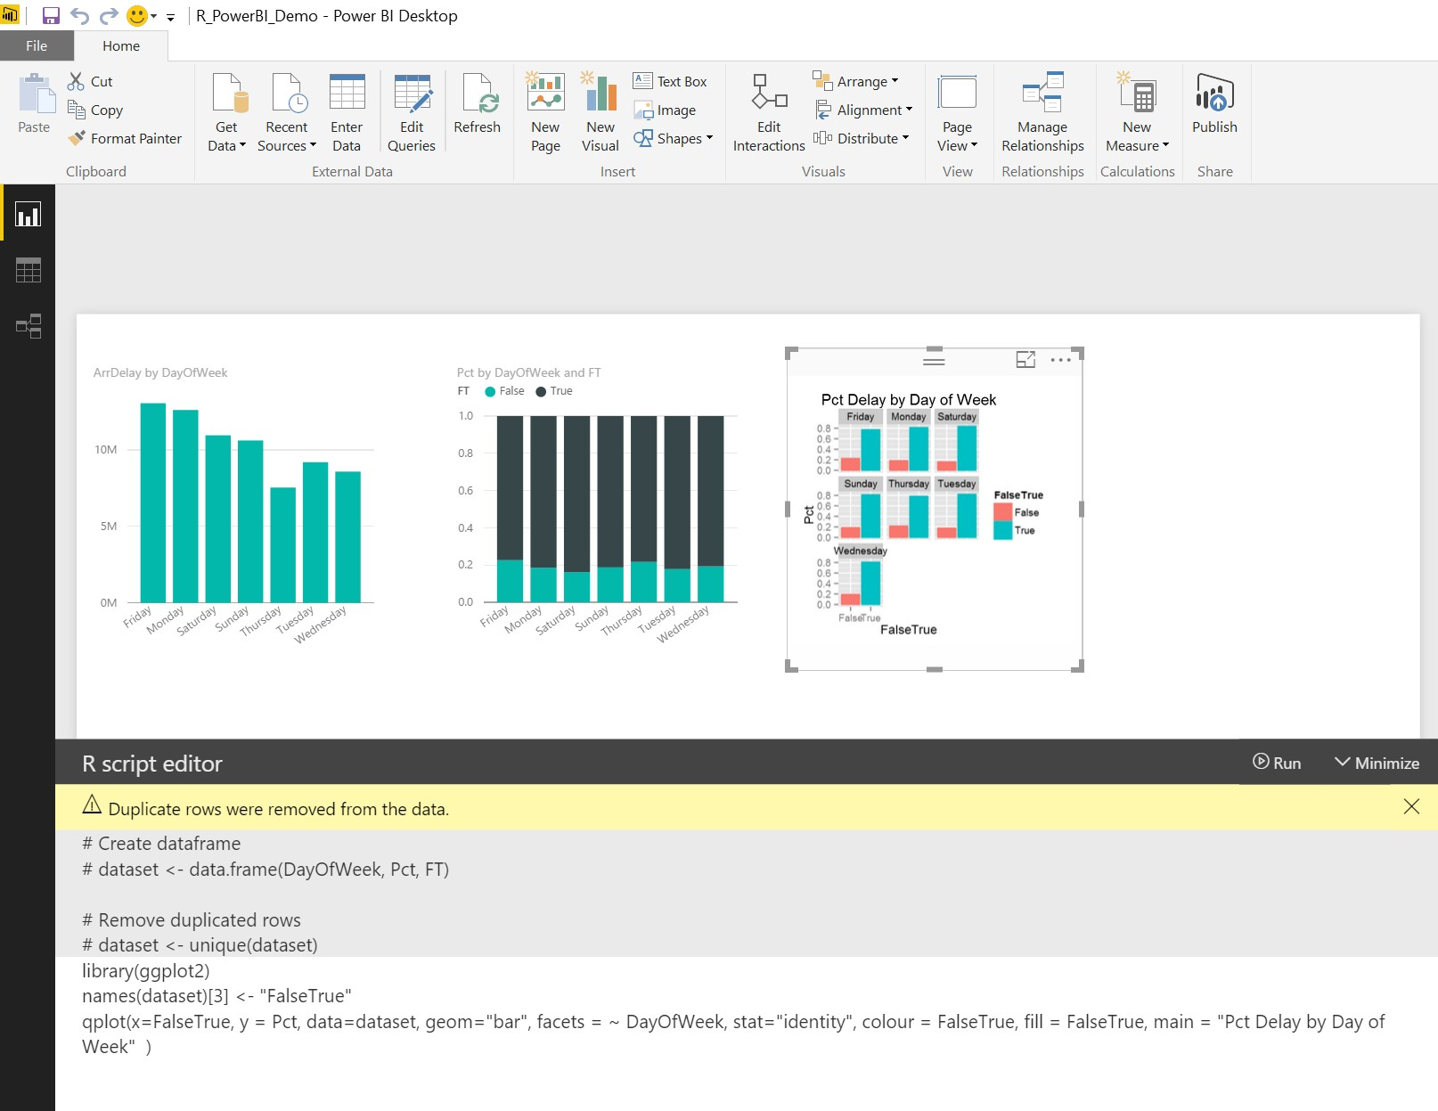
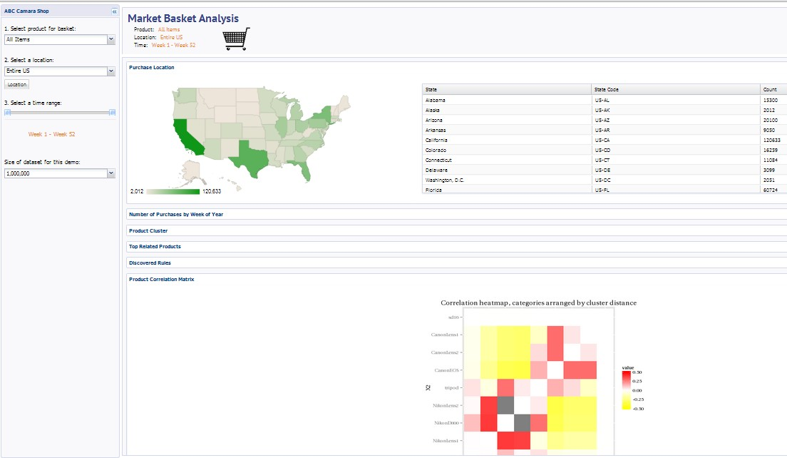
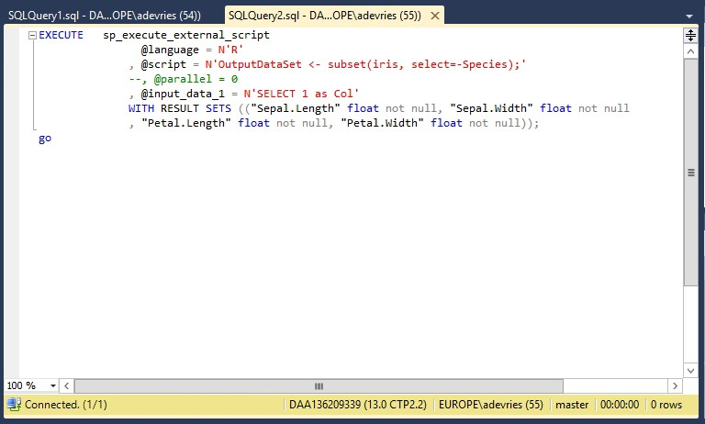

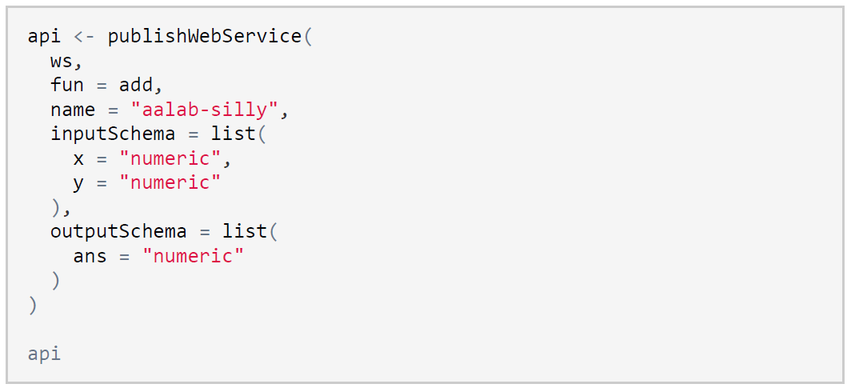

Slide 24



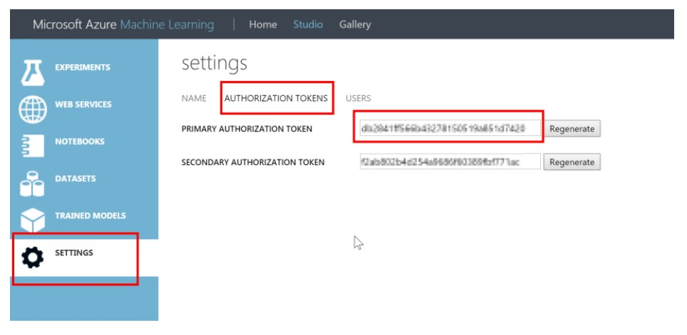
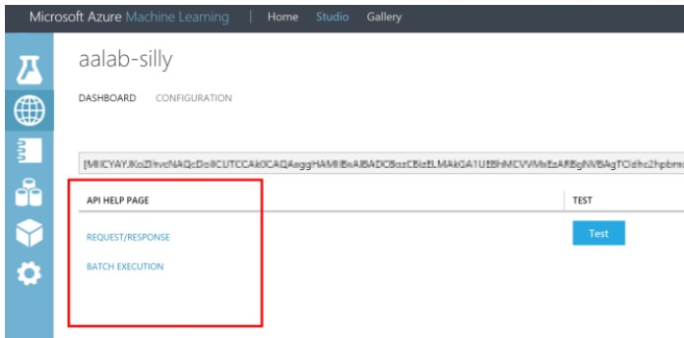
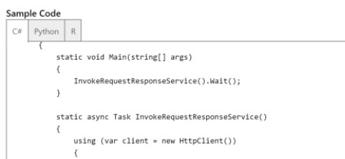
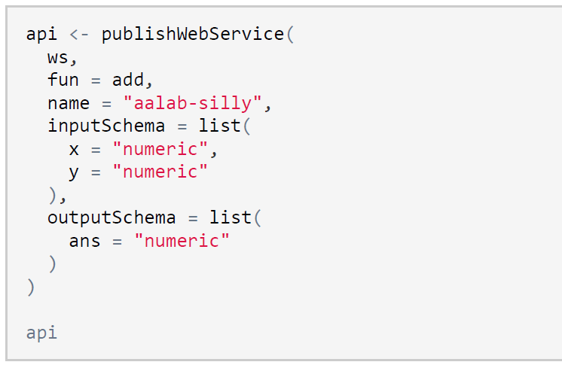
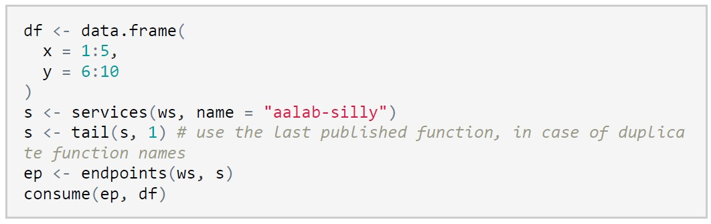
•
•
•
•
myWs <- workspace(id = "WORKSPACE ID", auth = "AUTH KEY",
api_endpoint = "https://europewest.studio.azureml.net", management_endpoint = "https://europewest.management.azureml.net")

Slide 25
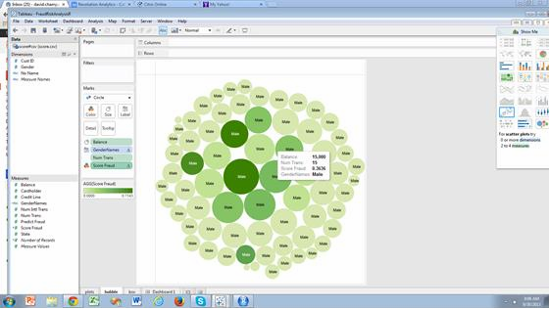
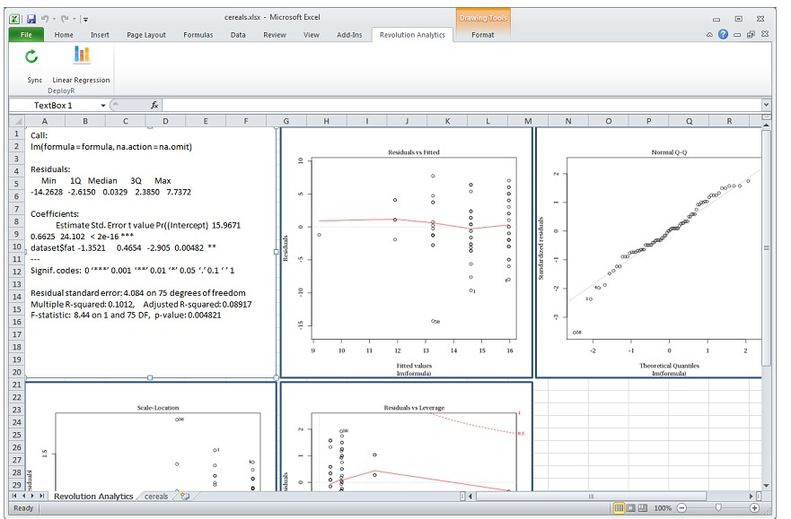
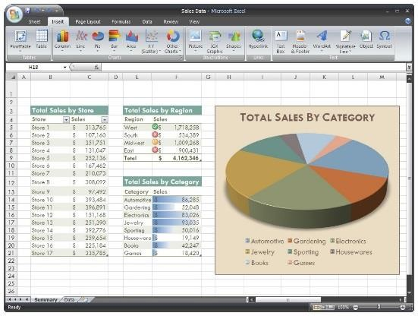
DeployR: example R as a service for BI / web apps
Example: Market Basket Analysis in HTML tool
Example: fraud analytics deployed to BI tool
Size of circles indicate credit card balance, and the darkness of the circle shows the prediction of fraud
Example: integration with Excel
Copyright Microsoft Corporation. All rights reserved.

Slide 26






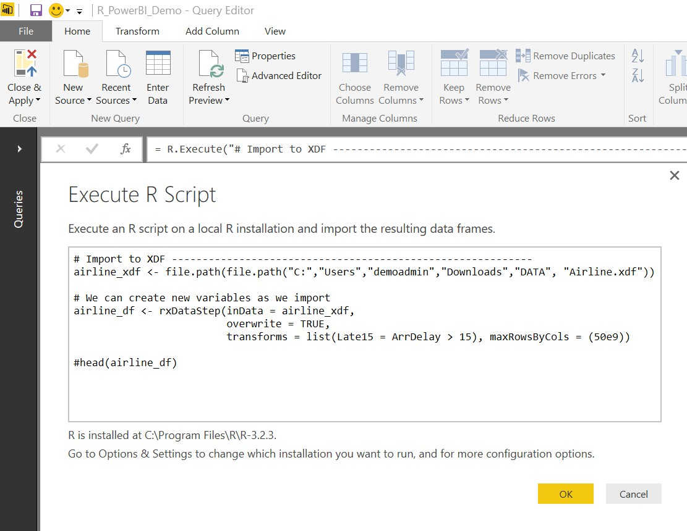

Slide 27

© 2017 Microsoft Corporation

